Slide 1
Final Project Presentation

Slide 2
Introduction
Project Goal
Automatically identify building footprints in satellite imagery using deep learning.
Motivation
Accurate building detection supports city planning, infrastructure assessment, and urban-growth analysis.
Dataset
SpaceNet-7 multitemporal satellite imagery with building-footprint annotations.
Approach
Train a U-Net CNN to perform pixel-level segmentation of buildings.
Outcome
Model produces building masks that capture major structures and general urban form.

Slide 3
Timeline
Final Adjustments
Information Gathering
Prototype
Training
Evaluation
Built up knowledge about our Dataset, what needed to be modified and processed
Working prototype using architecture we discovered in a kaggle notebook and made modifications
Trained the model for the first iteration and analyzed performance to see what it was missing
After editing the training we gave it withheld data to measure how it performs
By the end adjusted some hyperparameters to find a good fit for training and optimize our best model

Slide 4
References
Paper: U-Net Architecture
Paper: Metrics & Application
1
2
-Link: Paper
-Description: Paper compares several CNN architectures in a segmentation task similar to ours. U-Net performed best
-Link: Paper
-Description: Paper describing a similar segmentation task where they used dice coefficient as a loss function.
Kaggle Code Book: Chips
Kaggle Code Book: Model
3
4
-Link: Kaggle Book
-Description: Kaggle notebook with code to make chips from tiles from the dataset to feed into CNN. Catch finer details.
-Link: Kaggle Book
-Description: Kaggle notebook with code that had a definition for a U-Net architect that we modified and used.

Slide 5
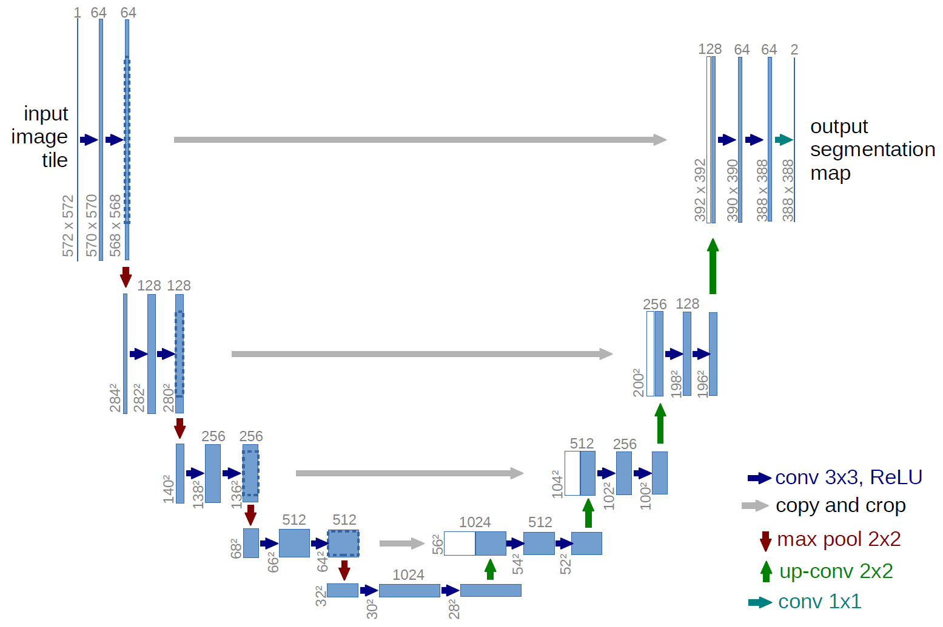
U-Net Architecture
Similar to Normal architecture with some changes:
Double Conv Layer: Pass input channel and output channel, creates down convolution and up convolution.
Architecture:
  4 Down Convolutions (Double Conv) with pooling
  Bottleneck
  4 Up Convolutions (Conv Transpose) with decoders
  Output Layer

Slide 6
Approach
Preprocessing
Training
Evaluation
Objectives
Activities
Deliverables
Take spacenet 7 and create smaller images to feed into model to provide more data, speed training, and notice finer details
Create U-Net structure from kaggle code book, and modify for our implementation. Have the model train and implement metrics and hyperparameters
Evaluate our model on withheld data and graph varying metrics to see it’s performance. Help to inform us where to improve
Create preprocess and data loader functions to take dataset and turn them into interpretable data for the model
Create Training Function with metric functions
Create U-Net Structure
Create evaluation function with several metrics and visualization functions
dataLoader.py
chips.py
train.py
U-Net.py
evaluate.py

Slide 7
Results
Epoch
Accuracy
IoU
Loss
Dice
1
0.864
0.145
2.037
0.233
10
0.929
0.267
1.442
0.388
20
0.935
0.295
1.295
0.421
30
0.942
0.335
1.187
0.477
40
0.946
0.382
1.114
0.517
50
0.951
0.446
1.009
0.583

Slide 8
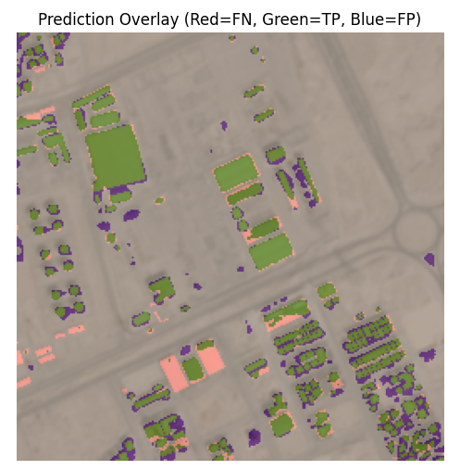
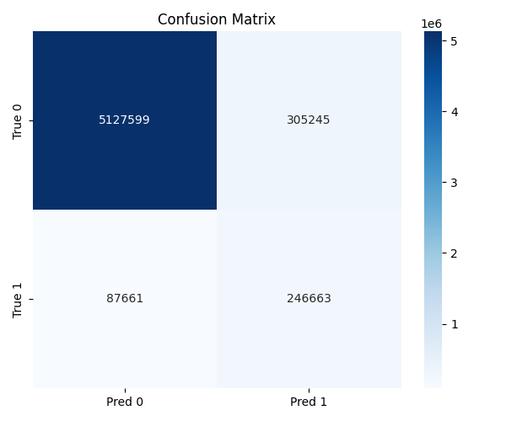
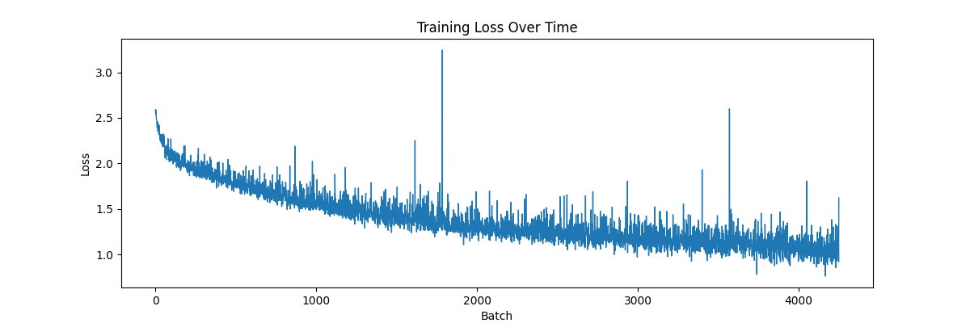
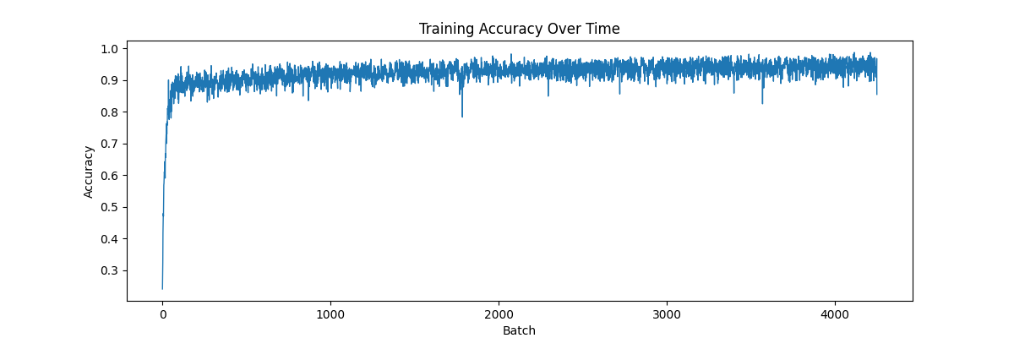
Interpreting Results
Training
Evaluation
After having the model train over 50 Epochs we notice a few things. Accuracy has an initial spike early on a slowly plateaus, our early stopping criteria will stop the model to prevent overfitting, however our data shows slow improvement over time.
During evaluation we give the model data it has not seen before and record how well it performs on data it has not seen and show some visuals of the predictions.
Accuracy: 0.951
IoU: 0.446
Loss: 1.009
Dice: 0.583
High accuracy, but low IoU and Dice, model’s accuracy is influence by TN pixels
Example Prediction and Confusion Matrix:
We notice it predicts well on this sparse picture with few houses. Take note of incorrect predictions. Across all predictions, performs best by predicting nothing.

Slide 9
Limitations
Model Limitations
• Struggled with irregularly shaped or non-rectangular buildings.
• Frequently misclassified shadows as building regions.
• Difficulty separating small, densely packed structures.
• Produced masks that bleed beyond true building boundaries.
Data & System Constraints
• Full-resolution images are large, requiring extensive preprocessing to reduce memory and storage demands.
• Preprocessing itself is slow because of the size of the dataset.
• Limited variation in lighting—mostly overhead—reduces the model’s exposure to diverse illumination conditions.
• Landscapes lack diversity, narrowing the range of building types and textures seen during training.
• Spatial resolution is too coarse for very small buildings, leaving some structures only a few pixels wide and hard for the model to detect.

Slide 10
Conclusions
Summary:
Build U-Net semantic segmentation model to detect buildings in SpaceNet7 satellite imagery.
Developed a full pipeline:
  Dataset loading
  Chip Generation
  Training
  Evaluation
Outcomes:
Model learned to segment buildings
Produced meaningful visuals and data
Technicals:
Custom weight loss functions
Penalties for false positive and false negative
Early stopping, schedulers
Overall:
Project has room for improvement , but demonstrates that with preprocessing, loss balancing, and model design satellite imagery can effectively be segmented top detect buildings

Slide 11
Thank you

